Slide 1

Lip-Reading Using Deep learning Approaches
Computer & Automatic Control Engineering Department
19-8-2020

Slide 2
Team Members
Abd Elrahman Ahmed Khater
Ahmed Mohammed Sheha
Mohammed Elsayed Abu Gabal
Mohammed Moustafa Abd Elsalam
Mohammed Mohammed Farghali
Mohamed Mohammed Gnana
Hagar Metwalli Mohammed

Slide 3
Outlines
05
Training Experience, System requirement and Demo
04
Dataset, Model and Future-work
03
Computer Vision and Deep learning Concepts and Modules
Web Application
02
System introduction and processing steps
01

Slide 4
System introduction and processing steps
01

Slide 5
Idea Concept
1
2
How Hearing Problems are solved
How our Application helps
(Sign language)
(DL model)

Slide 6
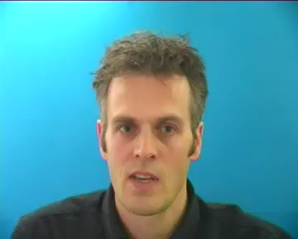
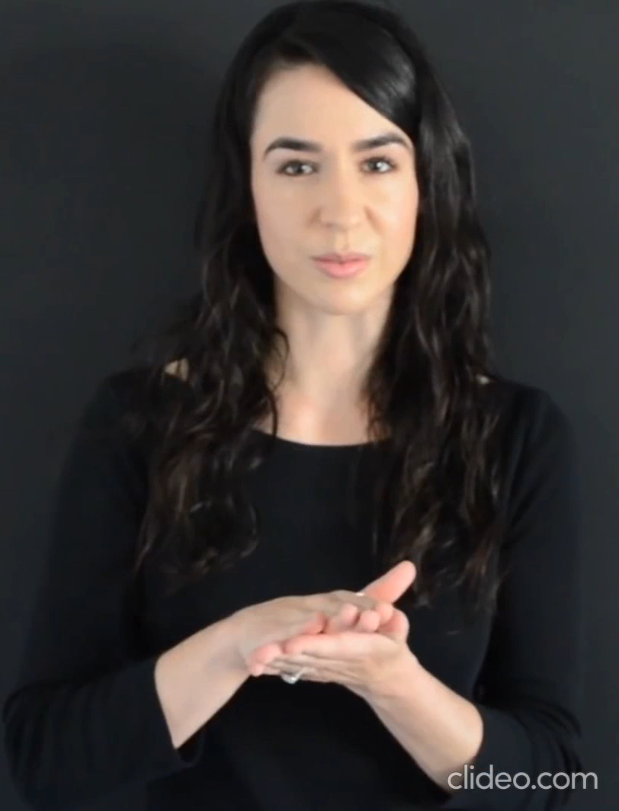
Example
Hello Welcome back

Slide 7
Approaches

Slide 8
1×1 Convolution Approach
Inception Approach
Attention Approach
Connections temporal classification Approach (CTC)

Slide 9
Applications

Slide 10
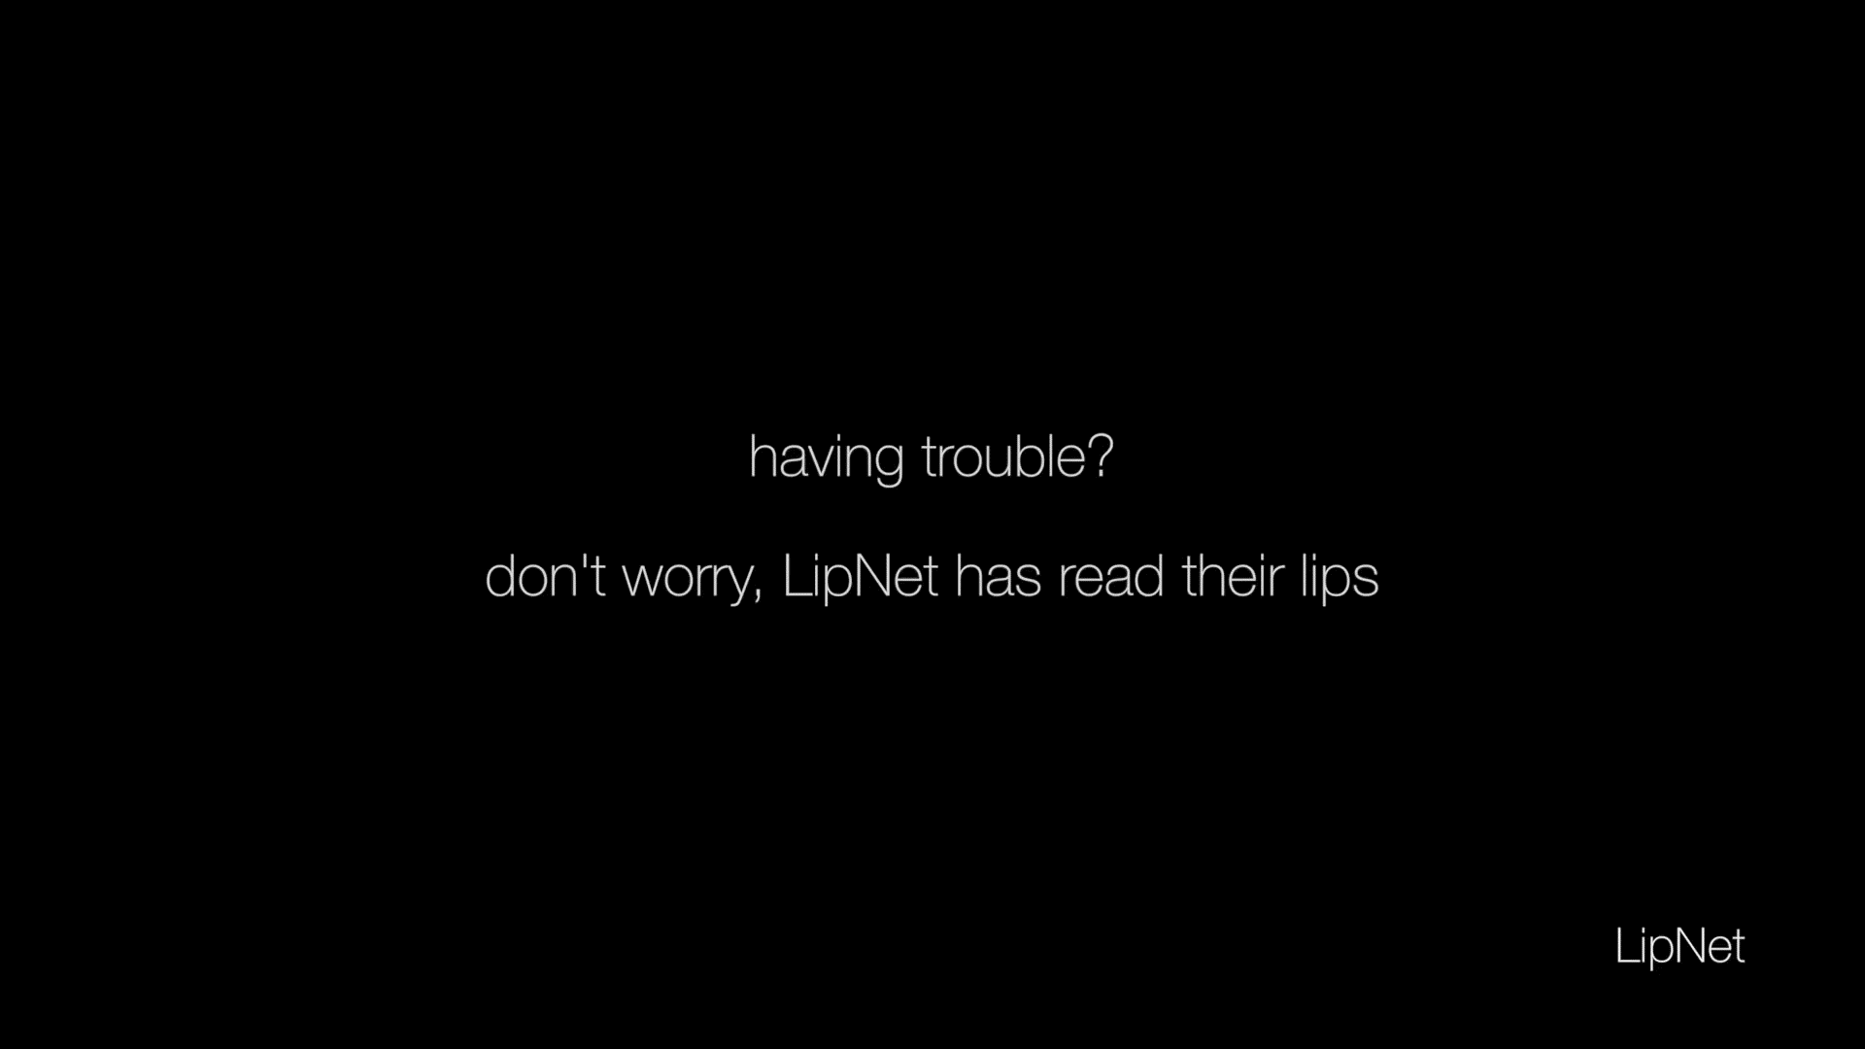
Autonomous Vehicles
Speech recognition in noisy environments

Slide 11

Security Camera processing
Analyze the surveillance cameras to deduce the conversation to find out what people are talking about

Slide 12
Process
The client uploads the required video
to our website to get the subtitle

Slide 13
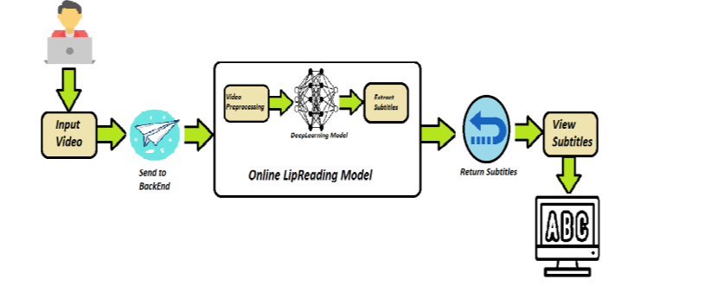
Processing Steps

Slide 14
Input Video

Slide 15
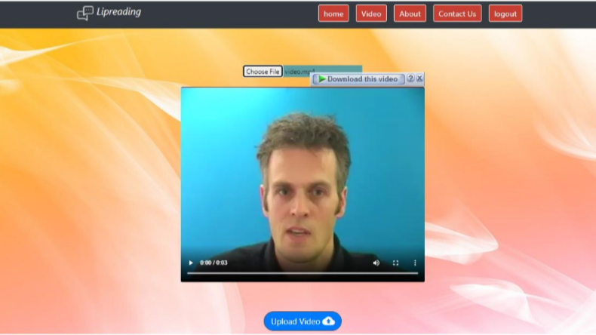

Slide 16
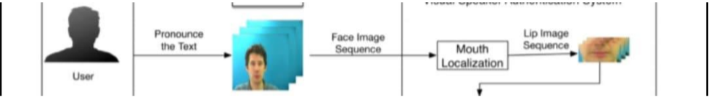
APIs Send the video to back end and extracting video frames
Online Lip-Reading model
pass the video frames to our model after preprocessing stage to predict the output subtitle of the video

Slide 17
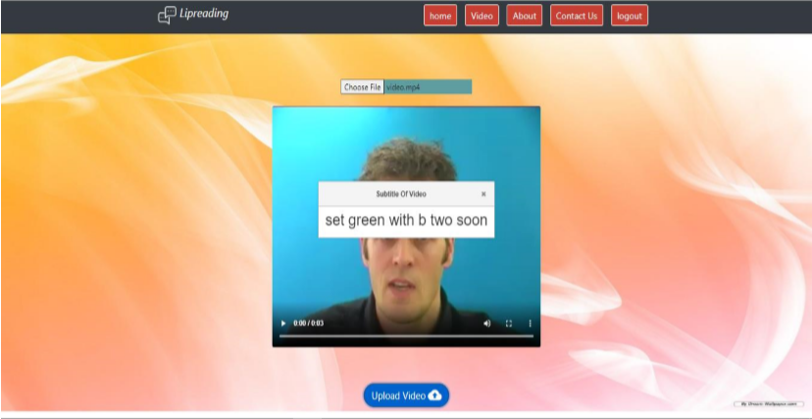
Returning the subtitle through APIs to front end

Slide 18
Web Application
02

Slide 19
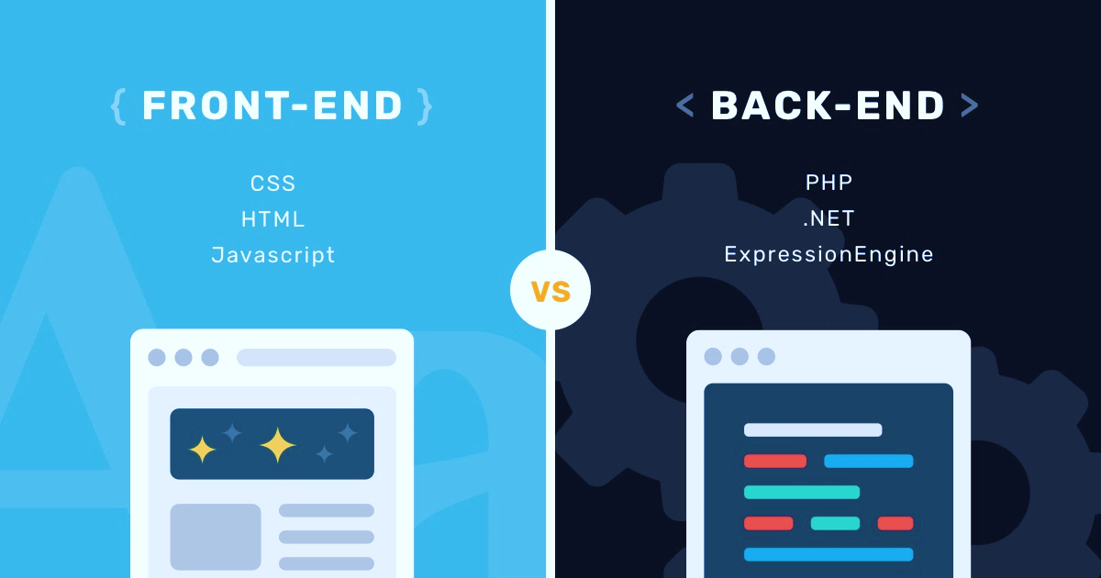
Web Application
As we know, Every WEB Application consists of Front-End and Back-End.
HTML
CSS
Bootstrap
Angular
Django Python
MongoDB

Slide 20






Angular
Speed
&
Performance
Framework which is used to create client applications in
HTML
CSS
Typescript
Code Reusability
Single
Page
App
Cross
Platform
Maximum
Users

Slide 21

Django
Django is a high-level Python Web framework that encourages rapid development and clean, pragmatic design. Built by experienced developers, it takes care of much of the hassle of Web development, so you can focus on writing your app without needing to reinvent the wheel. It’s free and open source.

Slide 22
Content
User pages
User Can Use It.
Admin pages
Only Admin Can See It.

Slide 23
User Pages
• Home
• Login
• Video
• About
• Terms of Service
• Privacy Policy
• FAQ
• Contact
User Data

Slide 24
.
• Home
• Login
• Video
• About
• Terms of Service
• Privacy Policy
• FAQ
• Contact
Users
Users Data
Admin Pages
.

Slide 25
Page Components
Navbar
Body
Footer

Slide 26
Pages

Slide 27


Home page

Slide 28
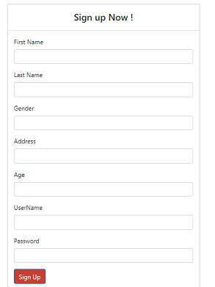
Sign Up
User can make account on site
Write His Data
This data stored in data base

Slide 29
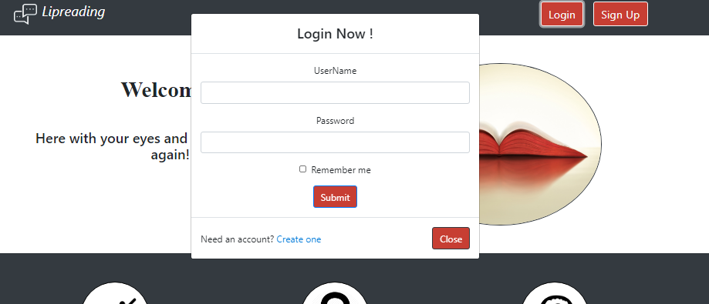

Slide 30
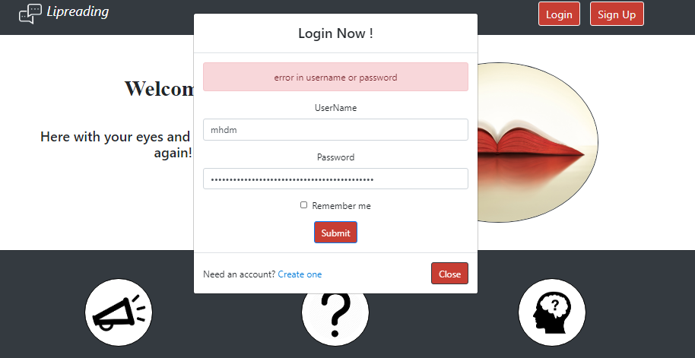
Login Error
User Can make login by
Entering his username and password.
Send this data to backend.
Test if this Data is correct
Return true and redirect
To video page.
If data incorrect
Backend return false
And show this form
Error in user or password

Slide 31

Error page
When anyone make request to any page inside of site without login
Will automatically redirect to error page
By use Can Activate

Slide 32
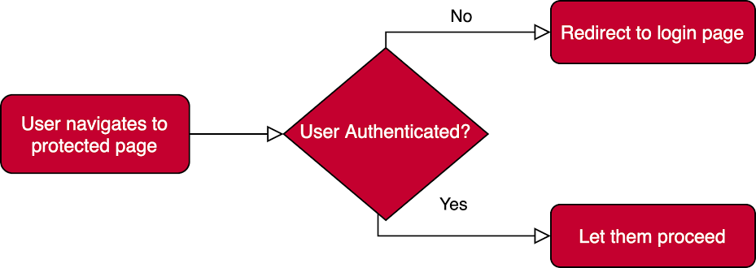
Can Activate
Interface that a class can implement to be a guard deciding if a route can be activated. If all guards return true, navigation continues. If any guard returns false, navigation is cancelled, And new navigation begins to the URL returned from the guard.

Slide 33

Video page
User chooses a video

Slide 34
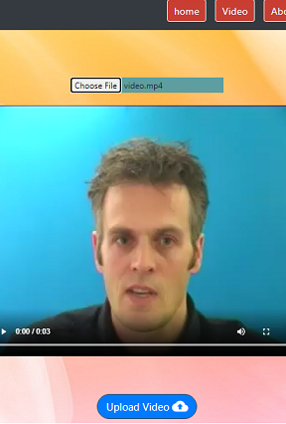
Choose a Video!
After choosing a Video:
it will appear and a button to get the Subtitle.
After pressing the button the video will be sent this to backend.
Backend receives the video , then run the model.
It will return the subtitle to the Frontend-Page.

Slide 35
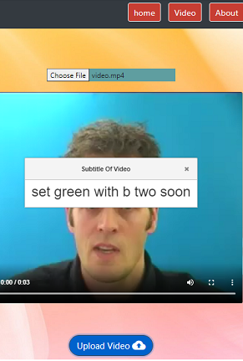
Get Subtitle
Backend will Return Subtitle
Frontend will receive this subtitle and view it in a dialog page.

Slide 36
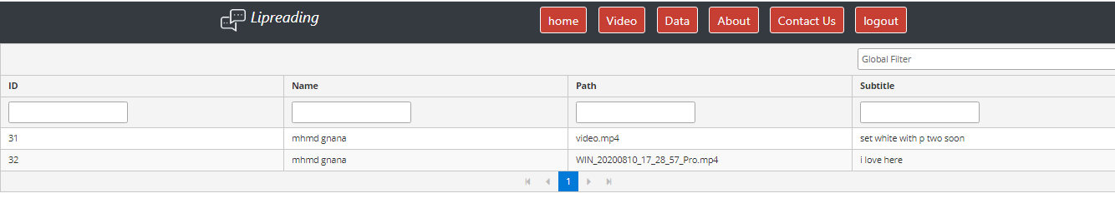
User Data
User can see his videos and Subtitles

Slide 37
.
• Home
• Login
• Video
• About
• Terms of Service
• Privacy Policy
• FAQ
• Contact
Users
Users Data
Admin Pages
.

Slide 38
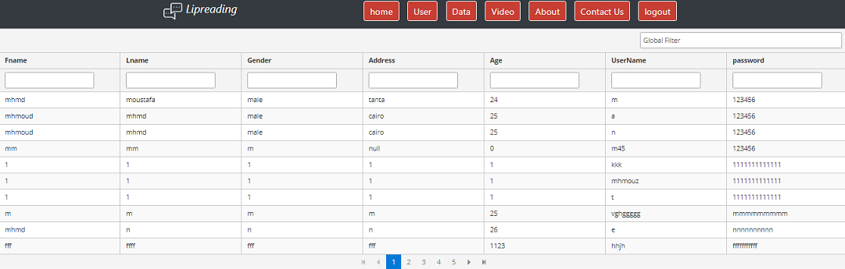
Users Page
Admin only can see all users’ Data.

Slide 39
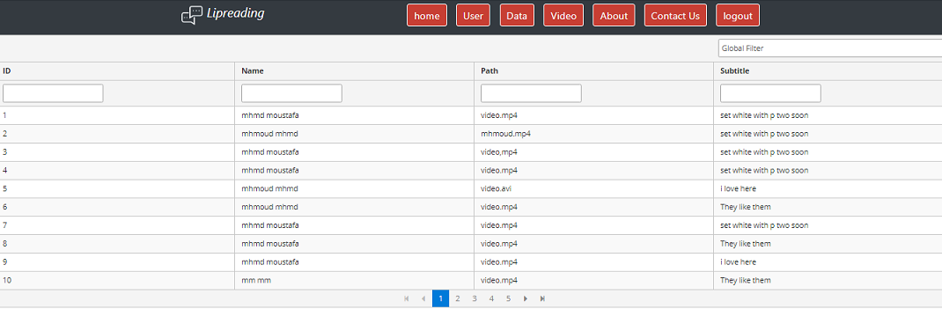
Data of videos
Admin only can see all Videos and Subtitle

Slide 40
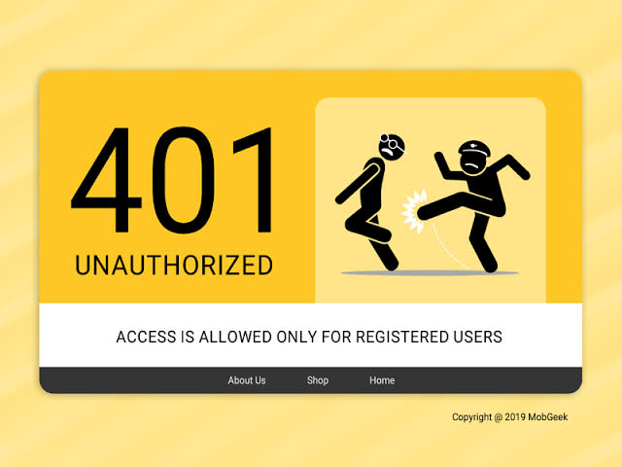
Unauthorized
Admins only can access Users Data or Data of videos pages.
If any user make request by URL to access this pages Can Activate will automatically redirect to 401 unauthorized page.

Slide 41
03
Computer Vision and Deep learning Concepts and Modules

Slide 42
Computer vision
Agenda:
1- What is Computer-Vision?
2- Traditional Computer-Vision vs. Modern Computer-Vision.
3- Artificial Neural-Networks, a brief introduction to Deep Learning.
4- What is The Convolution Operation? why CNNs rather than ANNs?
5- Deep-Learning for Computer-Vision.
6- Used Approaches In pre-processing from both Traditional and Modern CV.

Slide 43

What is Computer-Vision?
Vision - to see, is to know what (object) is where, only by looking.
Computer-Vision - to design a Computer model of Vision. The goal of Computer Vision is to solve the Vision problem.
Turing Test for Computer Vision – to Answer any Question regarding an image, which can be answered by a human.

Slide 44
What is Computer Vision and What is not?

Slide 45
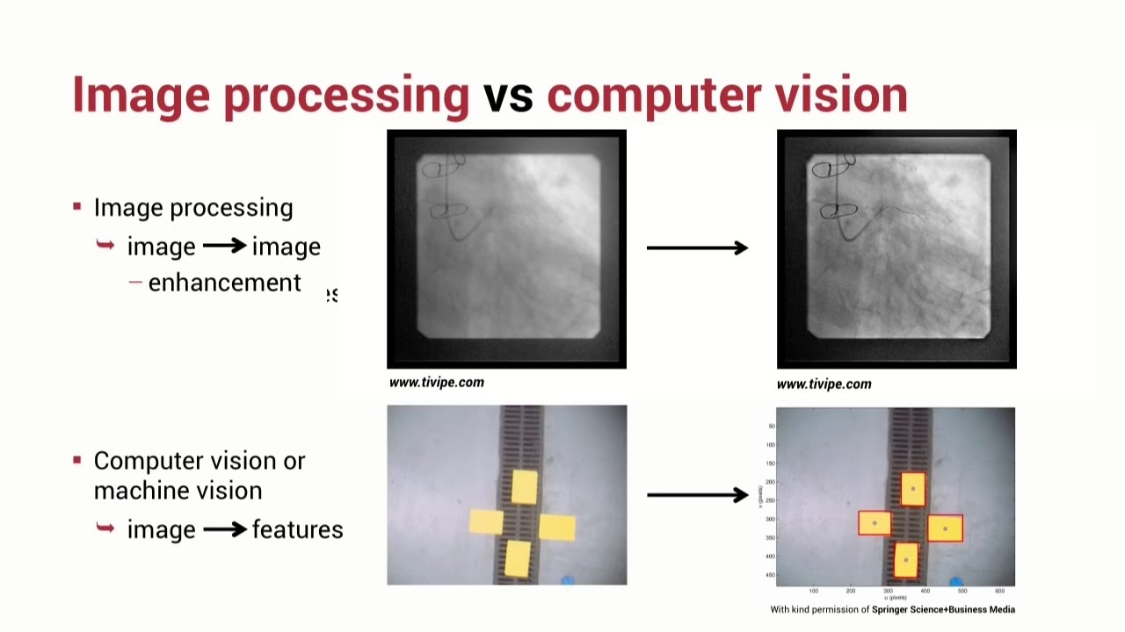

Slide 46
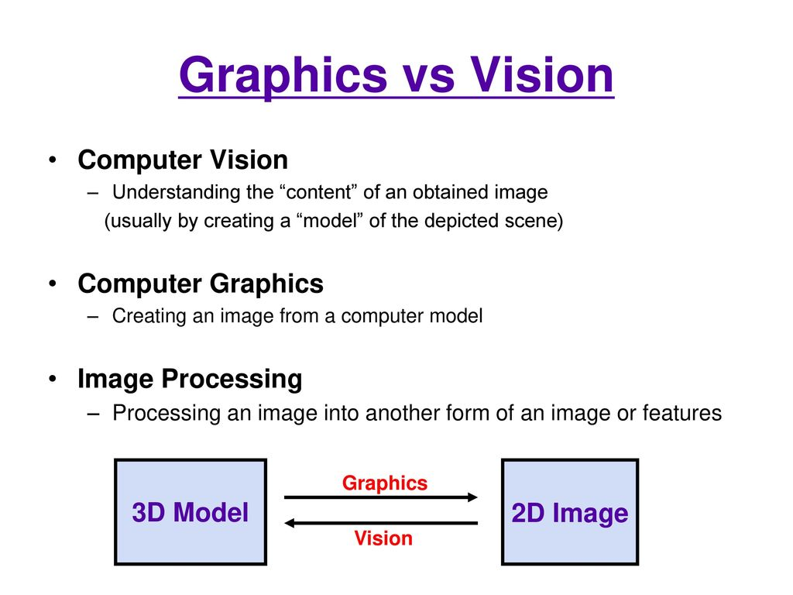
Computer Vision really makes a great use of a different Notions and fields of Science, But it has a Specific Definition!

Slide 47
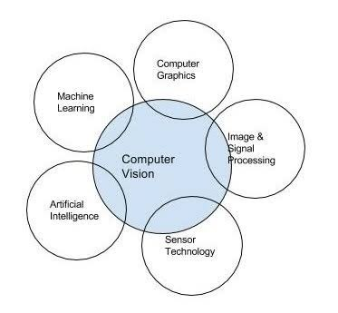
Intersection of Different Fields

Slide 48
Traditional Computer-Vision vs. Modern Computer-Vision.
Is DL making traditional Computer Vision (CV) techniques obsolete?
The traditional approach is to use well-established CV techniques such as feature descriptors (SIFT, SURF, BRIEF, etc.) for object detection (Before the emergence of DL).

Slide 49
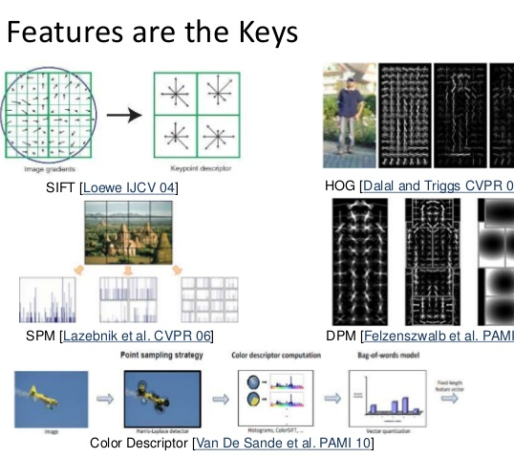
Features are small “interesting”, descriptive or informative patches in images.
Several CV algorithms, such as edge detection, corner detection or threshold segmentation may be involved.
As many features as practicable are extracted from images and these features form a definition (known as a bag-of-words) of each object class.

Slide 50
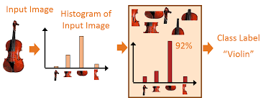
The Classification Process in Traditional Computer Vision

Slide 51
The difficulty with this traditional approach is that it is necessary to choose which features are important in each given image. As the number of classes to classify increases, feature extraction becomes more and more cumbersome. It is up to the CV engineer’s judgment and a long trial and error process to decide which features best describe different classes of objects. Moreover, each feature definition requires dealing with a plethora of parameters, all of which must be fine-tuned by the CV engineer.

Slide 52
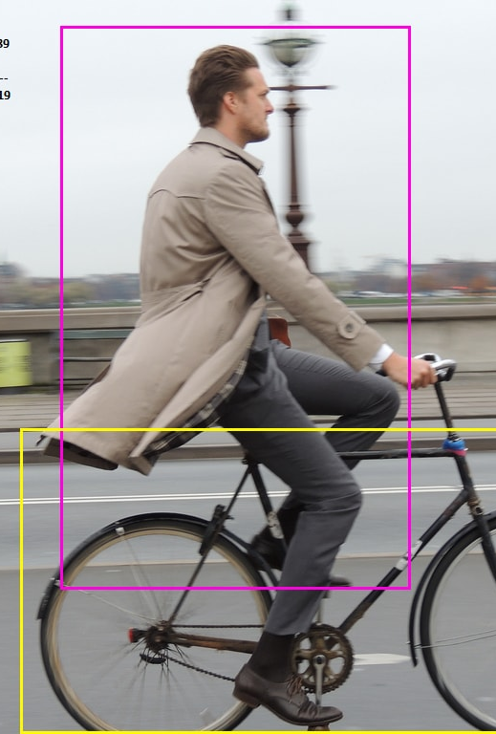
Modern CV = Deep-Learning in CV.
DL introduced the concept of end-to-end learning where the machine is just given a dataset of images which have been annotated with what classes of object are present in each image. Thereby a DL model is ‘trained’ on the given data, where neural networks discover the underlying patterns in classes of images and automatically works out the most descriptive and salient features with respect to each specific class of object for each object.

Slide 53

Artificial Neural-Networks, a brief introduction to Deep Learning
According to Arthur Samuel, Machine Learning algorithms enable the computers to learn from data, and even improve themselves, without being explicitly programmed. Machine learning (ML) is a category of an algorithm that allows software applications to become more accurate in predicting outcomes without being explicitly programmed.
Deep learning is a branch of machine learning which is completely based on artificial neural networks, as neural network is going to mimic the human brain so deep learning is also a kind of mimic of human brain.

Slide 54
Artificial neural networks & Deep neural networks.
ANNs are computing systems inspired by the biological neural networks that constitute animal brains. Such systems learn (progressively improve their ability) to do tasks by considering examples, generally without task-specific programming.
Typically, neurons are organized in layers. Different layers may perform different kinds of transformations on their inputs. Signals travel from the first (input), to the last (output) layer, possibly after traversing the layers multiple times.

Slide 55
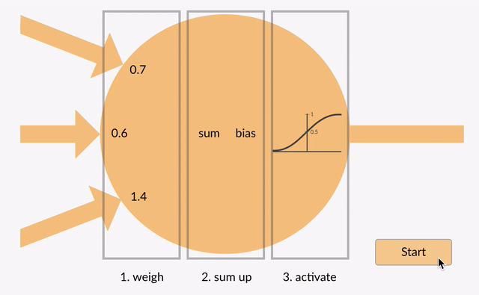

Slide 56
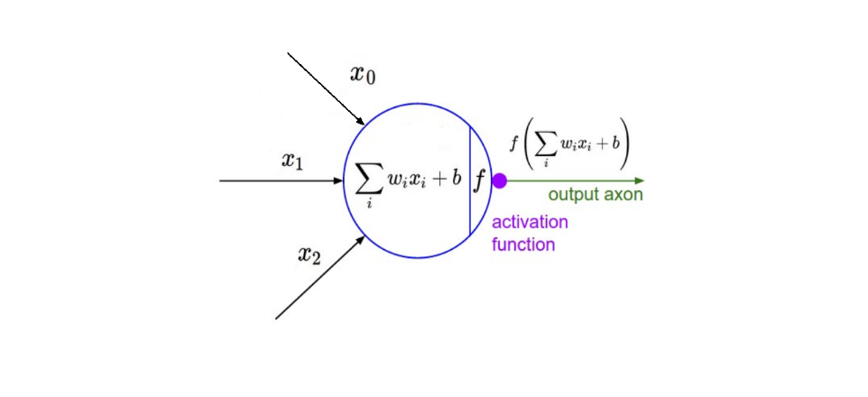
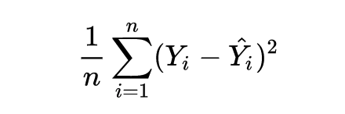
The major points to keep note of here are the tunable weight and bias parameters — represented by w and b respectively in the function above.
These are essential to the actual “learning” process of a deep learning algorithm. After the neural network passes its inputs all the way to its outputs, the network evaluates how good its prediction was (relative to the expected output) through something called a loss function.
The goal of the network is ultimately to minimize this loss by adjusting the weights and biases of the network. In using something called “back propagation” through gradient descent, the network backtracks through all its layers to update the weights and biases of every node in the opposite direction of the loss function — in other words, every iteration of back propagation should result in a smaller loss function than before.

Slide 57
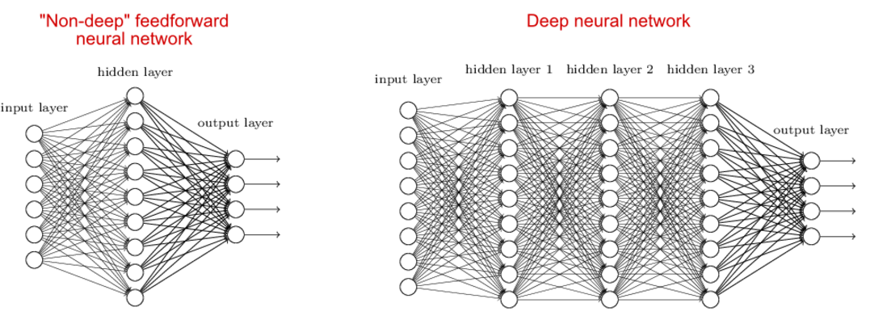

Slide 58
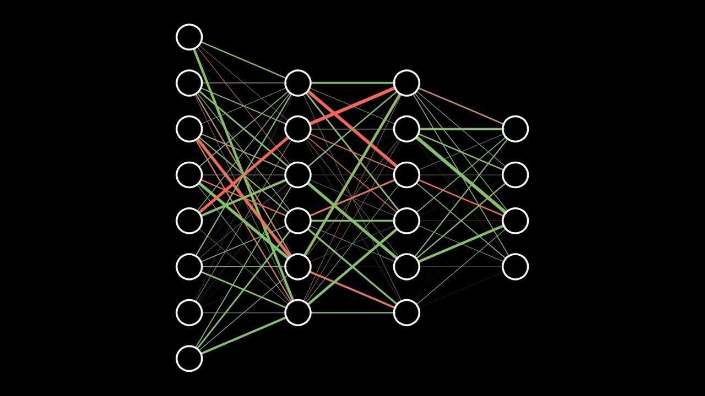

Slide 59
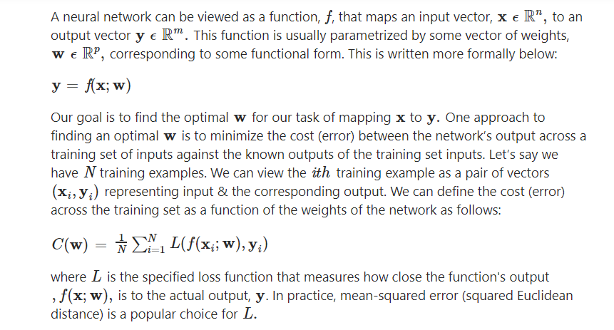
How is Learning done?

Slide 60
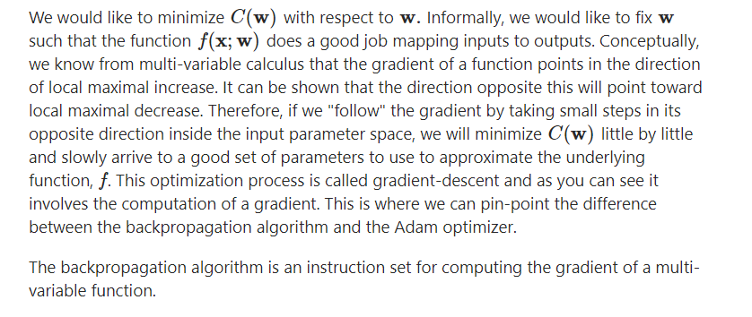

Slide 61
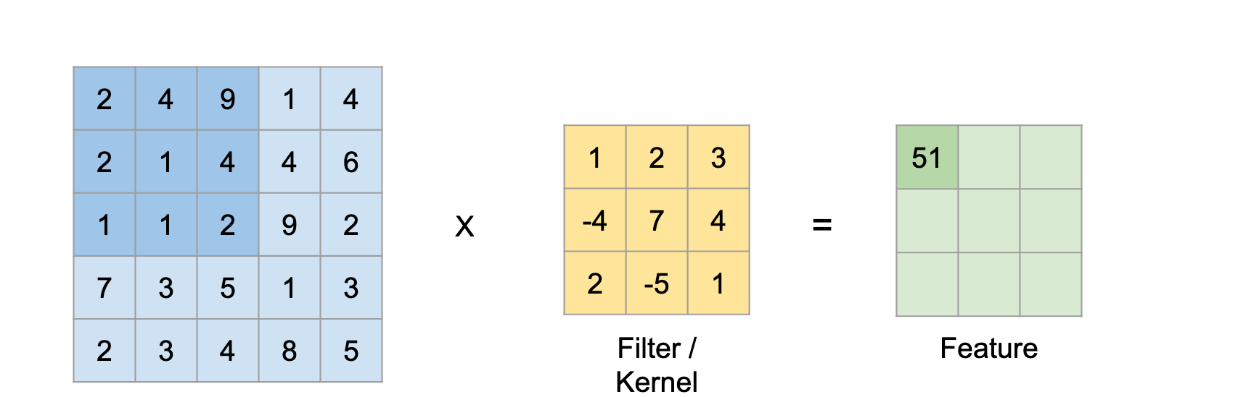
What is The Convolution Operation? Or: why CNNs rather than ANNs?
Convolution is essentially sliding a filter over the input.
Dr Prasad Samarakoon: “A convolution can be thought as “looking at a function’s surroundings to make better/accurate predictions of its outcome.”
rather than looking at an entire image at once to find certain features it can be more effective to look at smaller portions of the image.

Slide 62
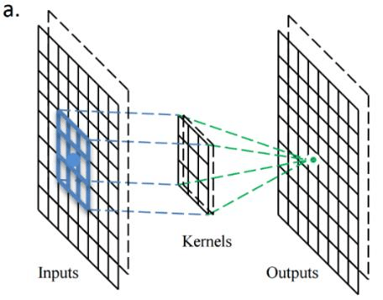
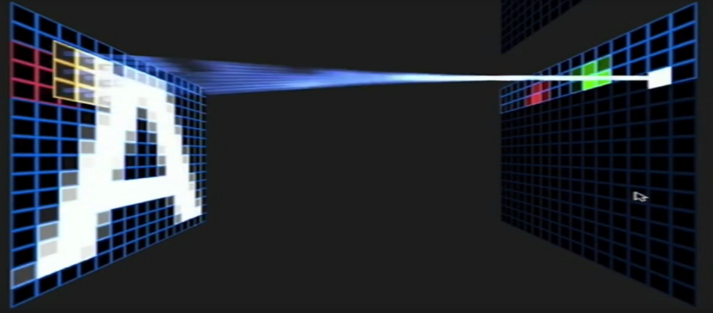

Slide 63
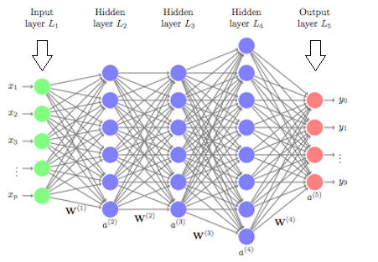
CNN classification v/s Artificial NN classification, why there is a significant difference in accuracy?
In the case of deep neural networks each neuron in each layer is fully connected to all the neurons in the previous layer as you can see in the below figure.
Because of this large number of connections the number of parameters to be learned increases. As the number of parameters increases the network becomes more complex. This more complexity of the network leads to overfitting.

Slide 64
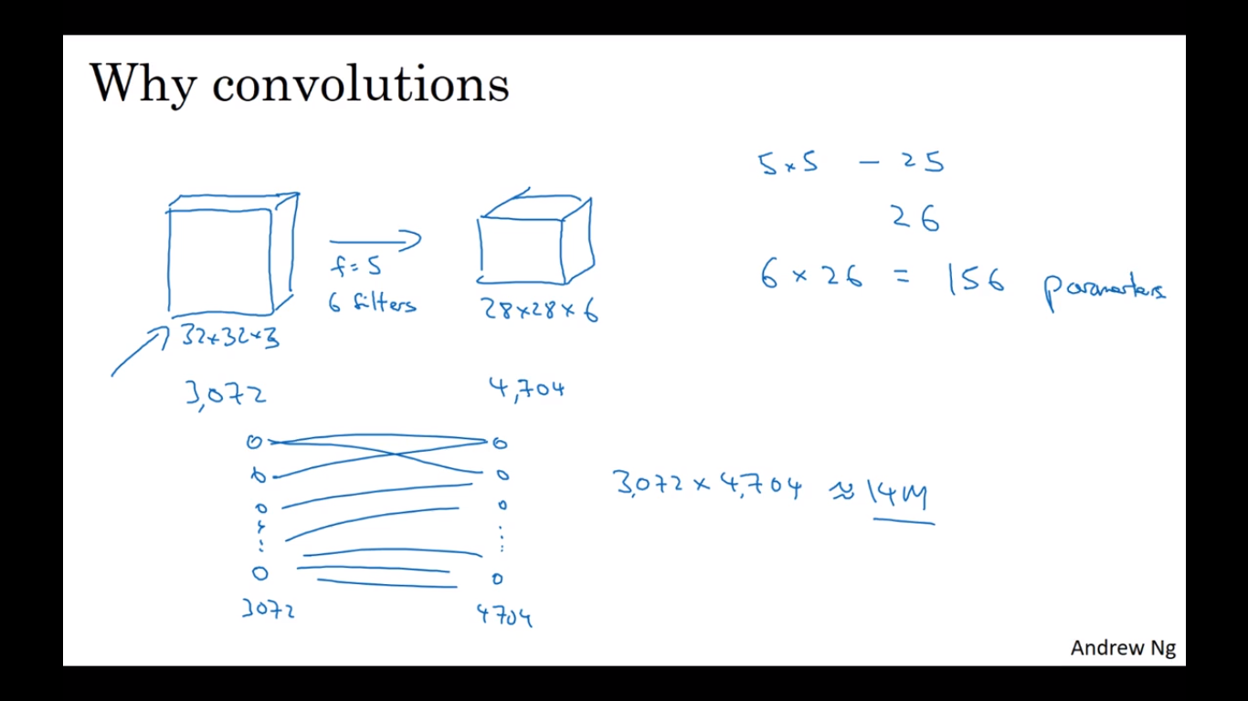

Slide 65
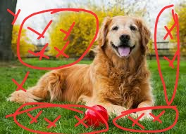
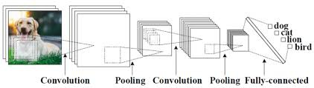
Especially, in the case of Image data being pixel values of the images as features, the number of input features would be of large dimension. This will increase the number of weight greatly as each pixel in the output will be related with some weight to every pixel in input image.
Every pixel in the output doesn’t need to be connected to a far away pixel in the input image.
To overcome these challenges, the Convolution Neural Networks were discovered. In this, the input image data will be subjected to set of convolution operations such as filtration and max pooling.
By performing the convolution operations, the dimensionality of the data shrinks significantly large. Hence, the number of parameters to be learned decreases. Hence, the network complexity decreases which leads to less chances of overfitting!

Slide 66
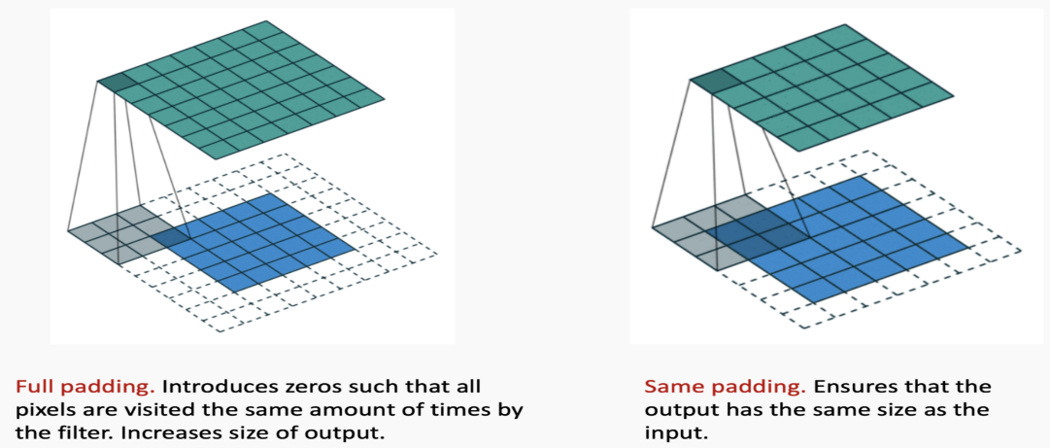
Deep-Learning for Computer Vision.
Padding:
If we apply convolutions on a normal image, the result will be down sampled by an amount depending on the size of the filter. We can use padding to prevent this to happen
Strides:
It is common to use a stride two convolution rather than a stride one convolution, where the convolutional kernel strides over 2 pixels at a time, for example our 3x3 kernel would start at position (1,1), then stride to (1,3), then to 1, 5) and so on, halving the size of the output channel/feature map, compared to the convolutional kernel taking strides of one.

Slide 67
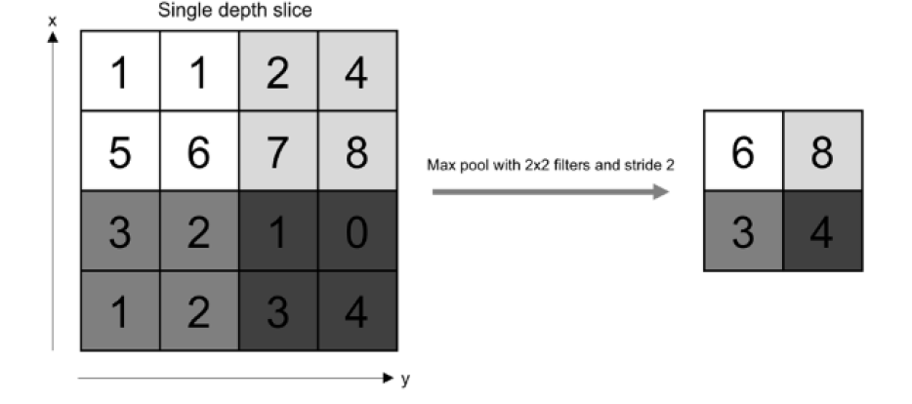
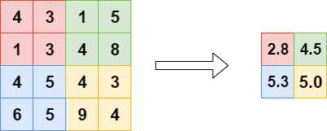
Pooling
Max Pooling
Average Pooling

Slide 68
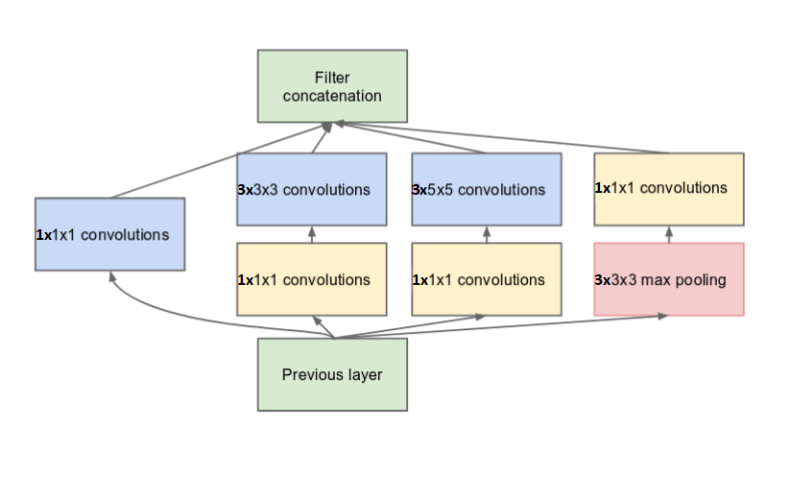
Going deeper with convolutions, Inception Network.
The main hallmark of this architecture is the improved utilization of the computing resources inside the network. This was achieved by a carefully crafted design that allows for increasing the depth and width of the network while keeping the computational budget constant.

Slide 69
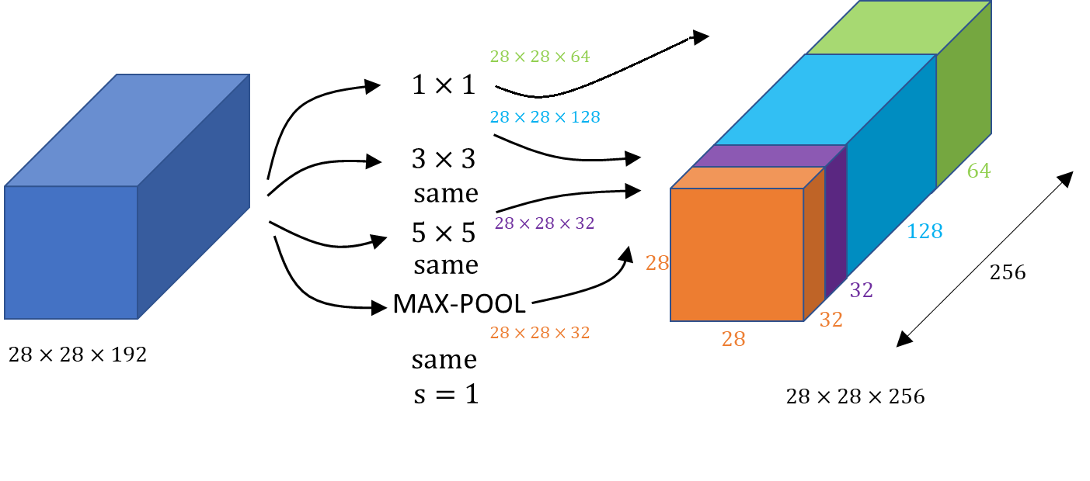

Slide 70
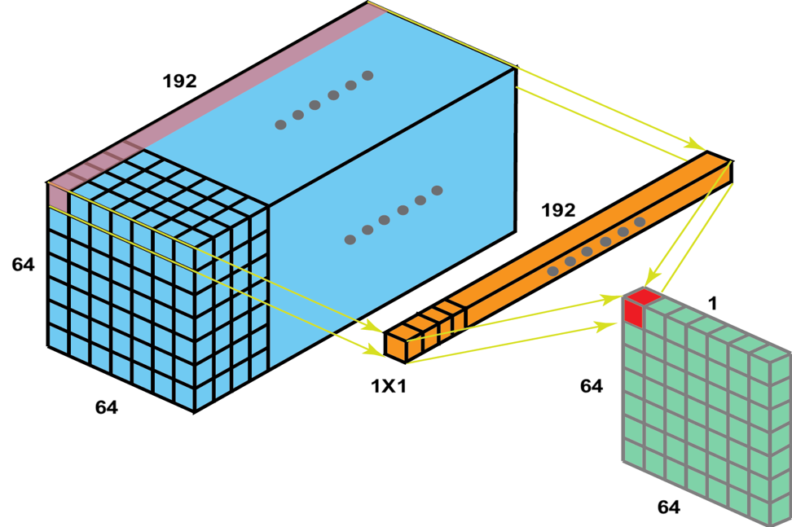
Network-in-Network
in order to increase the representational power of neural networks ,the method could be viewed as additional 1×1 convolutional layers, 1 × 1 convolutions have dual purpose.
they are used mainly as dimension reduction modules to remove computational bottlenecks, that would otherwise limit the size of our networks.

Slide 71
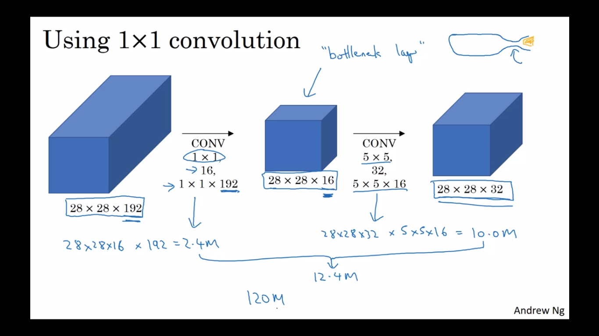

Slide 72
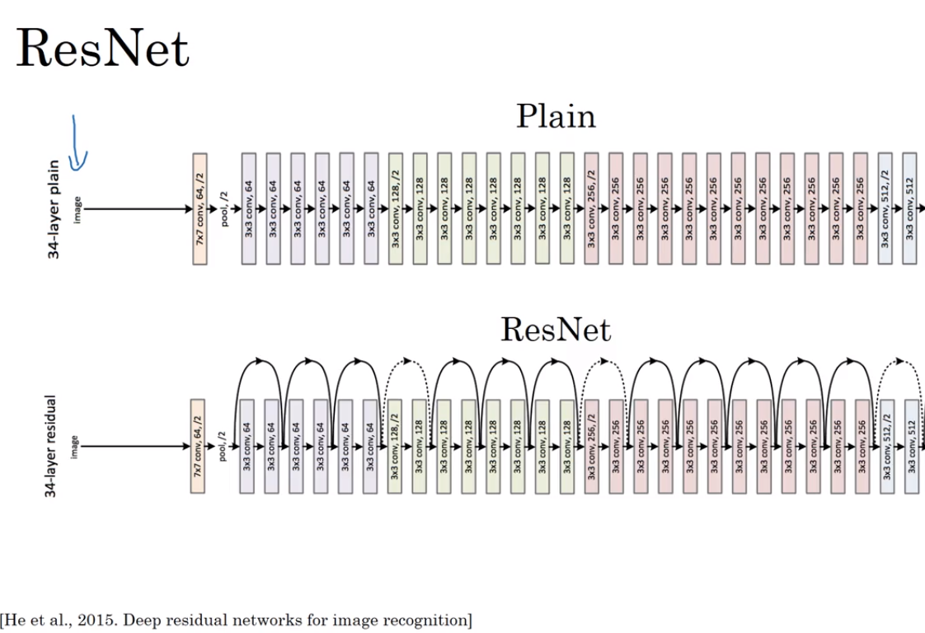
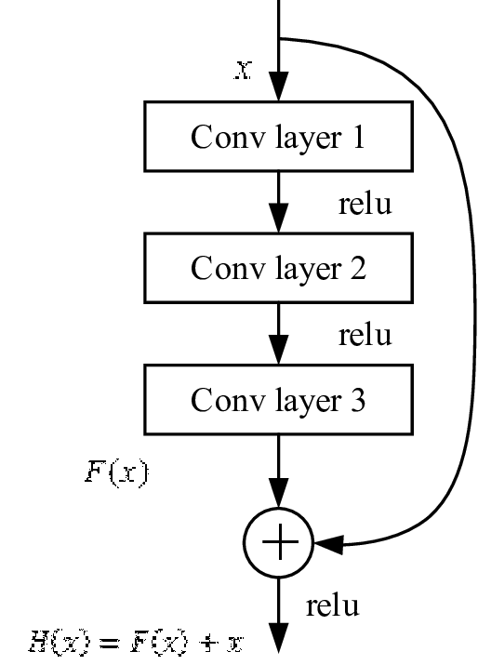
Residual Neural Network (ResNet).

Slide 73
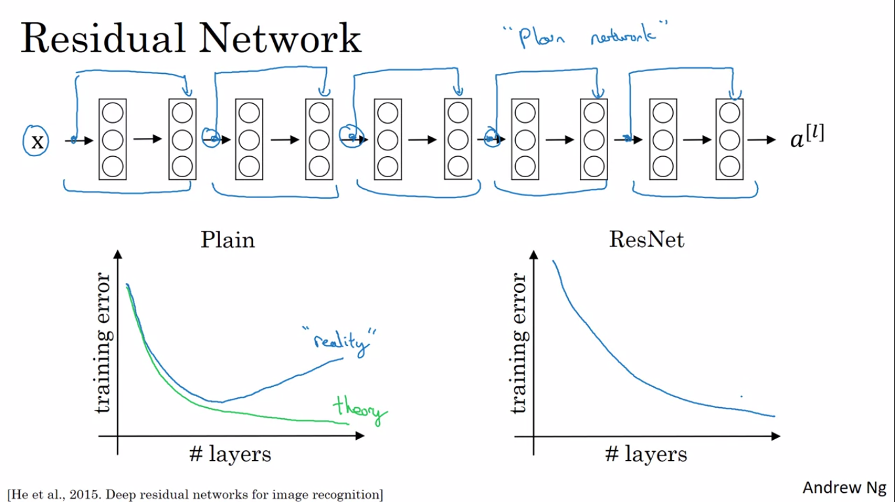
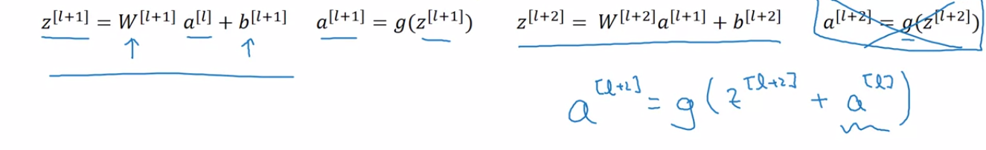

Slide 74
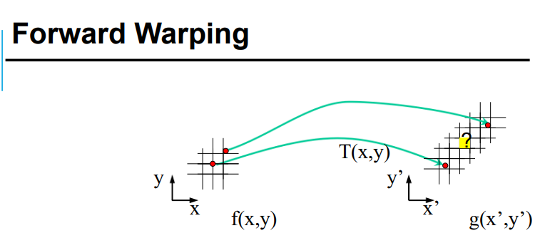

Used Approaches In pre-processing from both Traditional and Modern CV
Image Resizing and Interpolation:
Image interpolation occurs when we resize or distort the image from a pixel grid to another. Image resizing is necessary when we need to increase or decrease the total number of pixels.
Interpolation works by using known data to estimate values at unknown points. and tries to achieve the best approximation of a pixel’s intensity based on the values at surrounding pixels.
Interpolation is used during pre-processing (built in OpenCV library) in order to fix any distortion in images that may happen.

Slide 75


Slide 76



Slide 77
Mouth Extraction, dlib and OpenCV library and facial landmarks.
the input is one of the three forms “video, frames, NumPy array” and the output is the NumPy array or the “mathematical representation” of the frames of the video.
First, the video, we process the video using OpenCV library and capture each frame of the video.
Frames can contain “face, mouth” of the speaker.
The content is mouth, then the frame axes are asserted to be in the form W x H x C (NumPy array) is passed to the model.
We first need to extract the mouth and do some processing to the frame using dlib.

Slide 78

The facial landmark detector included in the dlib library is an implementation of the One Millisecond Face Alignment with an Ensemble of Regression Trees paper by Kazemi and Sullivan (2014).
The pre-trained facial landmark detector inside the dlib library is used to estimate the location of 68 (x, y) coordinates.

Slide 79

Recurrent Neural Network (RNN)
A recurrent neural network (RNN) is a type of artificial neural networks designed to recognize a data's sequential characteristics and use patterns to predict the next likely scenario.
allowing information to be stored within the network. In short, Recurrent Neural Networks use their reasoning from previous experiences to inform the upcoming events.
RNNs have a wide range of Applications , some of them are:
- Machine Translation.
- Time series prediction.
- Speech recognition
- Sentiment analysis.
- Handwriting recognition

Slide 80

How RNNs Work
RNN is recurrent in nature as it performs the same function for every input of data while the output of the current input depends on the past one computation.
After producing the output, it is copied and sent back into the recurrent network. For making a decision, it considers the current input and the output that it has learned from the previous input.

Slide 81

RNN Input- Output Scenarios

Slide 82

RNN captures the sequential information present in the input data i.e. dependency between the words in the text while making predictions
As you can see here, the output (o1, o2, o3, o4) at each time step depends not only on the current word but also on the previous words.

Slide 83

Challenges of simple RNNs
One common problem in all these neural networks is the Vanishing problem. This problem is associated with the backpropagation algorithm.
The weights of a neural network are updated through this process by finding the gradients
The gradients carry the information used in the RNN parameter update, and when the gradient becomes smaller and smaller, the parameter updates become insignificant which means no real learning is done
To face the problems of Vanishing gradients we use variations of RNNs that uses special units in addition to standard units:
Long Short-Term Memory (LSTM)
Gated Recurrent Unit (GRU)

Slide 84





Long Short-Term Memory (LSTM)
The LSTM operates using three gates: input, forget, and output - denoted as i , f , o , x(t) is the input at time t , h(t-1) is the previous hidden state LSTM added on the cell memory c(t) as a way to store information over long time-spans in particular
Forget gate state is used to decide what information we’re going to throw away from the cell state. This decision is made by a sigmoid layer , It looks at h(t−1) and x(t), and outputs a number between 0 and 1 for each number in the cell state Ct−1. , 1 represents “completely keep this” while a 0 represents “completely get rid of this.”
input gate state has two parts , first part decides what new information we’re going to store in the cell state. Next, a tanh layer creates a vector of new candidate values, C~t, that could be added to the state.
Finally, we need to decide what we’re going to output. This output will be based on our cell state. First, we run a sigmoid layer which decides what parts of the cell state we’re going to output. Then, we put the cell state through tanh and multiply it by the output of the sigmoid gate, so that we only output the parts we decided to.
to update the old cell state, Ct−1 into the new cell state Ct We multiply the old state by the forget gate Then we add it∗C~t

Slide 85

Gated Recurrent Unit (GRU)
GRU, was developed later, simplifies the LSTM by combining both the cell memory and the hidden-state.
and combines the forget and input gates into a single gate called update gate z(t).
The update gate controls information that flows into memory, and the reset gate controls the information that flows out of memory , in other words The reset gate r controls if the previous hidden state needs to be ignored
The GRU controls the flow of information like the LSTM unit, but without having to use a memory unit. It just exposes the full hidden content without any control.

Slide 86
Why did we choose GRU over LSTM?
GRU uses less training parameters and therefore uses less memory, executes faster and trains faster than LSTM's whereas LSTM is more accurate on dataset using longer sequence.
GRU is relatively new, and from my perspective, the performance is on par with LSTM, but GRU is computationally more efficient (less complex structure as pointed out). So we have been seeing it being used more and more.

Slide 87

The problem of long sequences
Long sequence models are normally composed of an encoder-decoder architecture, where the encoder processes the input sequence and encodes/compresses/summarizes the information into a context vector of a fixed length. This representation is expected to be a good summary of the entire input sequence. The decoder is then initialized with this context vector, using which it starts generating the transformed output.
A critical and apparent disadvantage of this fixed-length context vector design is the incapability of the system to remember longer sequences. Often is has forgotten the earlier parts of the sequence once it has processed the entire the sequence
This technique works good for smaller sequences, however as the length of the sequence increases, a single vector becomes a bottleneck and it gets very difficult to summarize long sequences into a single vector

Slide 88


Attention Mechanism
The attention mechanism was born to resolve the problem of long sequences.
Instead of encoding the input sequence into a single fixed context vector, the attention model develops a context vector that is filtered specifically for each output time step.
we architect a model in such a way, we need to have a context of words that the network pays attention to, in order to generate the subsequent words , (α) denote how much attention should be paid to each piece of the original sentence.
The model is composed of two RNN networks. A bidirectional RNN/LSTM/GRU to compute set of features for each of the input words and another RNN to generate the English translation. The input to the second RNN will be governed by the attention weights, which denote the context that is considered by every single word to compute the translation.
The “c” context is the weighted sum of the attention weights.
How to compute α <t,t’> ?
One way to do it is to train a small neural network where the inputs are represented by the network state in the previous time step (s<t1>) and the features from the time step t’ (a<t’>).

Slide 89
Dataset, Model and Future-work
04

Slide 90

Dataset Characteristics
Datasets:
(AVICar, AVLetters, AVLetters2):
For only one word.
GRID corpus:
which has audio and video recordings of 34 speakers who produced 1000 sentences.
GRID corpus grammar:
command (4) + color(4) + preposition(4) + letter(25) + digit(10) + adverb(4)

Slide 91


Dataset | Training Examples
Dataset:
Videos:
Videos are stored as .mpg files with resolution 75x288x360x3.
Sentence:
Sentences are stored as .align files.
GRID Dictionary:
Dictionary is stored as .txt file and contain all possible sentence outcome.
Training Example

Slide 92

Model | Structure

Slide 93

Model | Dataset preprocessing
Preprocessing Layer:
Using OpenCV and Dlip Libraries to perform Video preprocessing.
Video preprocessing steps:

Slide 94

Model | Dataset preprocessing
Preprocessing Layer:
Using python code to perform sentence preprocessing.
Sentence preprocessing steps:

Slide 95
Model | Dataset augmentation
Video augmentation:
We created our own augmenter, which take only all the allowed words from our speakers and create all the possible video sentences with the allowed name.
We call it LDVA(Lip-reading Dataset Video Augmenter).
We used moviePy Library
Wrote sentence augmentation:
Similar to the video augmenter we created the sentence augmenter and store it in a .txt file with the same name.
In normal python code.

Slide 96

Model | Dataset Augmentation

Slide 97
Model | Dataset augmentation
Limitations:
Although our video augmenter work very well, It was created using a disconnected words, there is no problem with that for a normal case.
But we already trained our model on the GRID Corpus, in which the sentences are spoken continuously
So training from scratch is needed, or like our case the accuracy will decrease.
We intend to try it in the future.

Slide 98

Model | Layers
Layers:
Units size
Padding
Stride
Number of kernels

Slide 99



Model | Layers| Filters
Layers | Filters:
We focused only on the first 3 inception layers since we can sketch the filters and outputs.
We plotted only 3 frames and the 3x3x3 and 5x5x5 filters to illustrate our points.
Filters Examples

Slide 100




Model | Layers | Outputs
Layers | Outputs:
We focused only on the first 3 inception layers since we can sketch the filters and outputs.
We plotted only 3 frames and the first 8 channels filters to illustrate our points.
output Examples

Slide 101

Model | Layers | CTC
Connectionist Temporal Classification:
loss function
Alignment free function
We have 28 label:
(26 character + space + blank)
Blank label is inserted between actual characters.
Example: for 10 frames
let (‘a’---’1’),(‘t’---20),(‘blank’ ‘_’ ---27),(‘space’ ‘ ‘ ---28)
[1,1,1,27,27,20,20,27,27,28]
‘aaa__tt__ ‘ ------ ‘at’
Done at the decoding time.

Slide 102
Model | Decoding
Decoding:
Greedy Search
Beam Search
Correction

Slide 103
Model | Optimizers
Optimizers:
Batch gradient
Stochastic gradient descent
Mini-batch gradient descent
Gradient Descent with momentum
RMSprop
Adam (Used)

Slide 104
Model | Limitations
Limitations:
The model is over-fitting for several reasons linked the original dataset used:
Native English speaker
Skin color, specially in the Unseen speakers' dataset
The number of words in the sentence
The structure of the sentence

Slide 105
Model | Future-work
Future Work:
New English and Arabic data sets
New English and Arabic dictionaries
New mobile application using flutter platform
Voice Enhancement application

Slide 106

Model | Future-work

Slide 107

Model | Future-work

Slide 108



Slide 109
05
Training Experience, System requirements and Demo

Slide 110

WER and CER
WER(Word Error Rate):
is a way to measure performance of an SR(Speech Recognition). It compares a reference to a hypothesis.
CER(Character Error Rate):
Edit Distance is a measure of similarity between two strings referred to as the source string and the target string.

Slide 111
Bleu Score
Actual : this is e cat
Desired: this is a cat
1gram
Sequence | Actual | Desired
this | 1 | 1
is | 1 | 1
e | 1 | 0
cat | 1 | 1
Bleu Score:
Is a metric for evaluating a generated sentence to a reference sentence.
Bleu Score = 0.75
2gram
Sequence | Actual | Desired
this is | 1 | 1
is e | 1 | 0
e cat | 1 | 0
Bleu Score = 0.333

Slide 112

Training Experience

Slide 113

Training Experience

Slide 114


Training Experience

Slide 115
System Requirements
NVIDIA TITAN X
1.5 TB of RAM

Slide 116
Corona Problem
At 14/3/2020, Egyptian Government had to announce stoppage of studying in Egyptian universities to avoid spreading corona virus
After that, We faced first problem where we will train our model
Solution: Cloud solutions for AI.

Slide 117
Azure
Egyptian government with our university afforded us with 100$ for each student with his university account on office 365:
Unfortunately, This financial aid couldn’t help us to train model.
It could almost finish our preprocessing phase.

Slide 118

Google Colab
With Google Colab, We could train our models without paying much money.

Slide 119

Google Colab
We decided to use Google Colab pro to save more time, get better results and try more model at the same time.

Slide 120

Automation
We used administration skills for automating our tasks by bash shell
Downloading datasets.
Preparing suitable environment with required libraries.
Preprocessing datasets.

Slide 121

Threading
We made faster preprocessing by threading programming.

Slide 122
Problems on cloud
Ram Limitation
We tuned size of batch for each model to get better results without needing more size from afforded RAM
Disconnect each 24 hours
We chose suitable number of videos to train model with enough number of epochs.
Stop training after disconnecting 2 hours
We found solution by JavaScript to reconnect automatically when Internet connection would return.
Disable of training with full videos to learn model
We made mixture of suitable number of videos from various speakers with different words and characters.

Slide 123
Any Question???

Slide 124
Thanks

